Slide 1
YEAR 6 – SURFACE CHANGES
How Did That Get There? - Photos

Slide 2
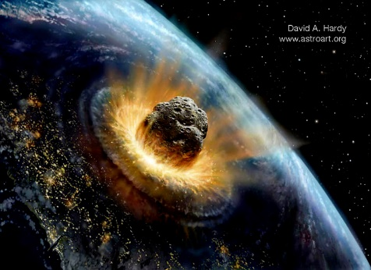
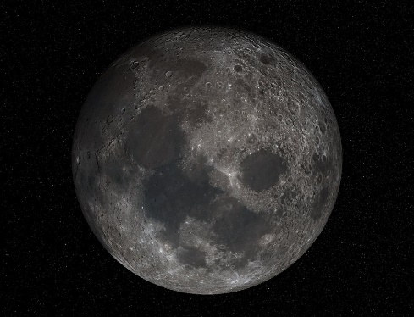
Impact Processes
Objects such as meteorites falling from space and changing the surface when they hit it.

Slide 3
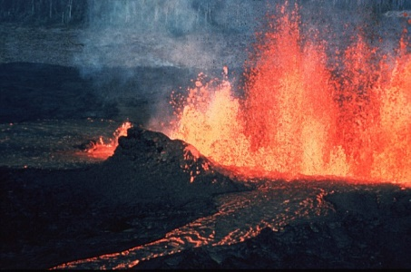
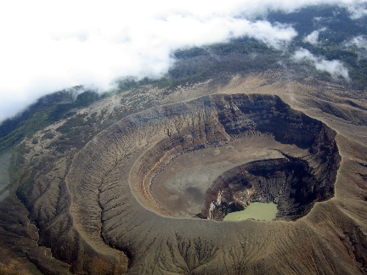
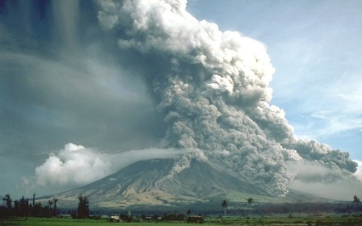
Volcanic Processes
Erupting volcanoes making new landforms when they erupt – changing height/shape.

Slide 4
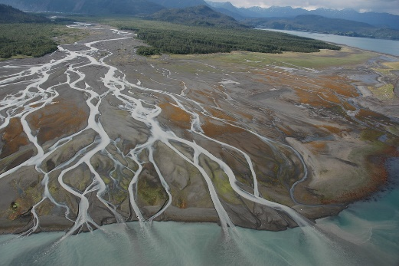
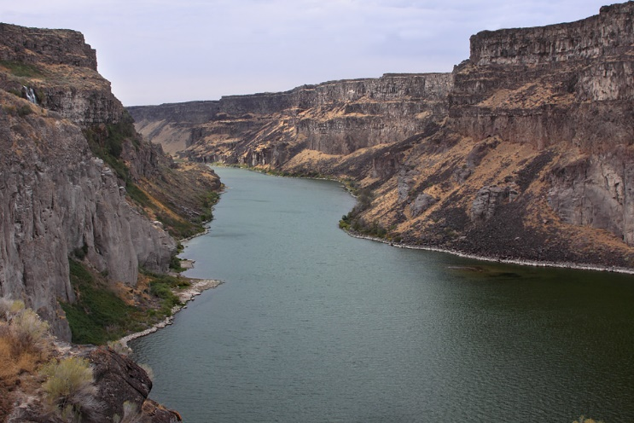
Fluvial Processes
Flowing water shaping a planet’s surface by removing or depositing materials.

Slide 5
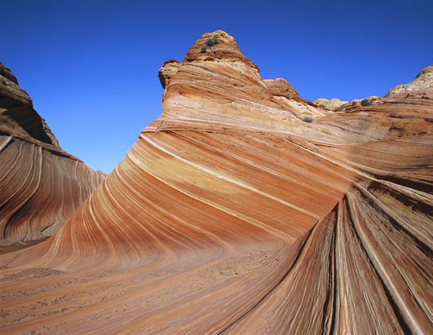
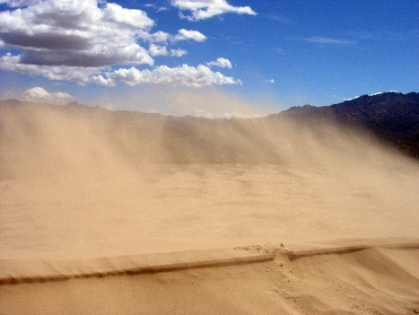
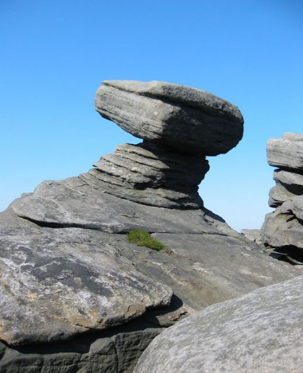
Aeolian Processes
The wind moving substances around or shaping hard surfaces by weathering and eroding them away.

Slide 6
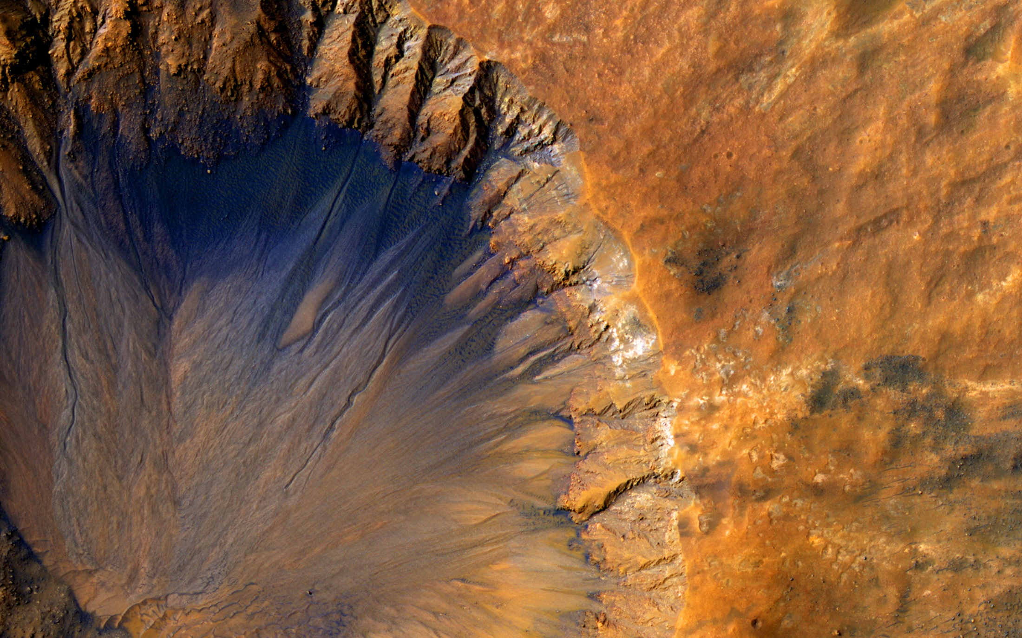
Notes:
Picture 1 - Mars. Impact crater in the Sirenum Fossae area on Mars.
Image credit: NASA/ JPL/ University of Arizona, Photo taken by the Mars Reconnaissance Orbiter (MRO)
https://www.nasa.gov/image-feature/fresh-crater-near-sirenum-fossae-region-of-mars

Slide 7
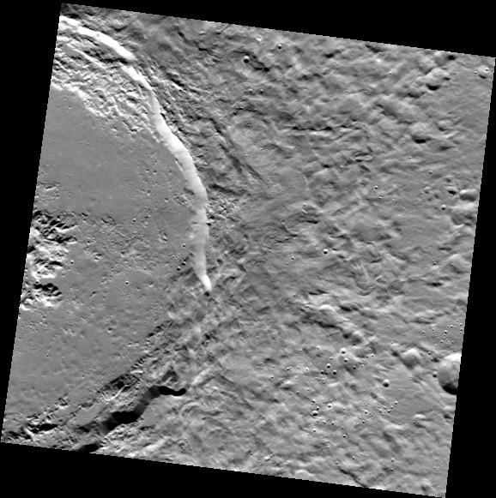
Notes:
Picture 2 - Mercury. Abedin impact crater on surface of Mercury. Image Credit: NASA/Johns Hopkins University Applied Physics
https://www.nasa.gov/mission_pages/messenger/multimedia/messenger_orbit_image20130522_1.html

Slide 8
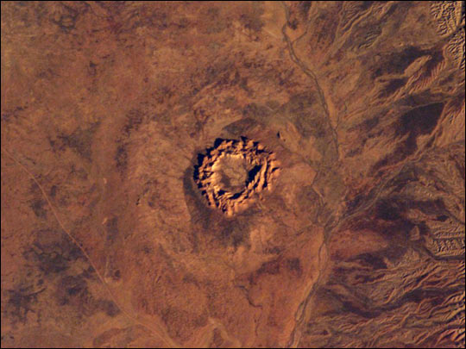
Notes:
Picture 3 - Earth. Gosses Bluff in the Northern Territory, Australia. An impact crater that is about 142 million years old.
Image credit: NASA/JSC Earth Science and Remote Sensing Unit.
https://www.earthobservatory.nasa.gov/IOTD/view.php?id=3548

Slide 9
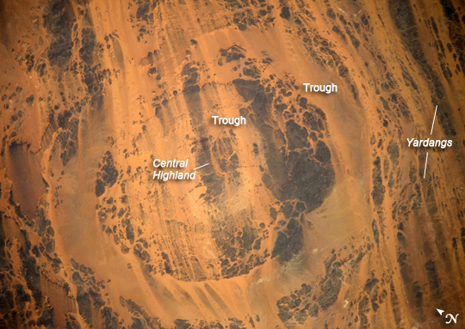
Notes:
Picture 4 - Earth. Aorounga impact crater in the Sahara desert, Chad. It is approximately 345-370 million years old.
Image credit: NASA/ JSC Earth Science and Remote Sensing Unit
https://earthobservatory.nasa.gov/IOTD/view.php?id=39727

Slide 10
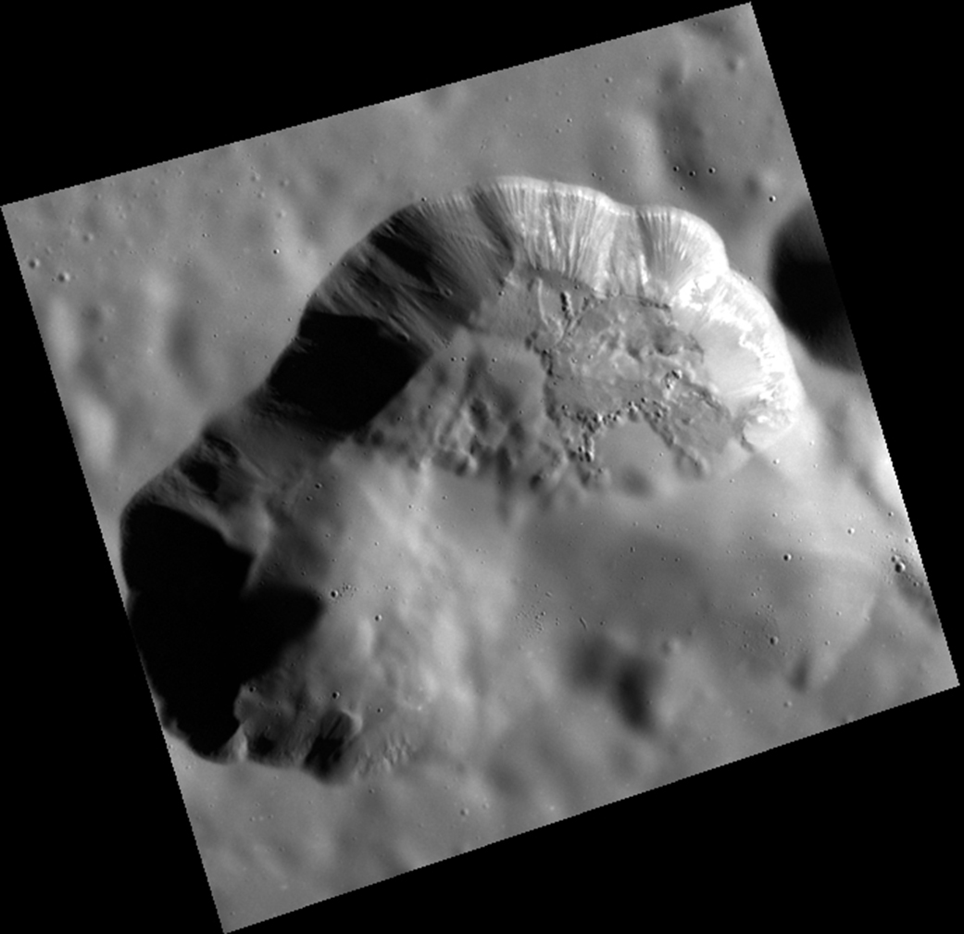
Notes:
Picture 5 - Mercury. Volcanic vent in the Rachmaninoff basin on Mercury.
Image credit: NASA/Johns Hopkins University Applied Physics Laboratory/Carnegie Institution of Washington
https://www.nasa.gov/image-feature/this-space-for-vent

Slide 11
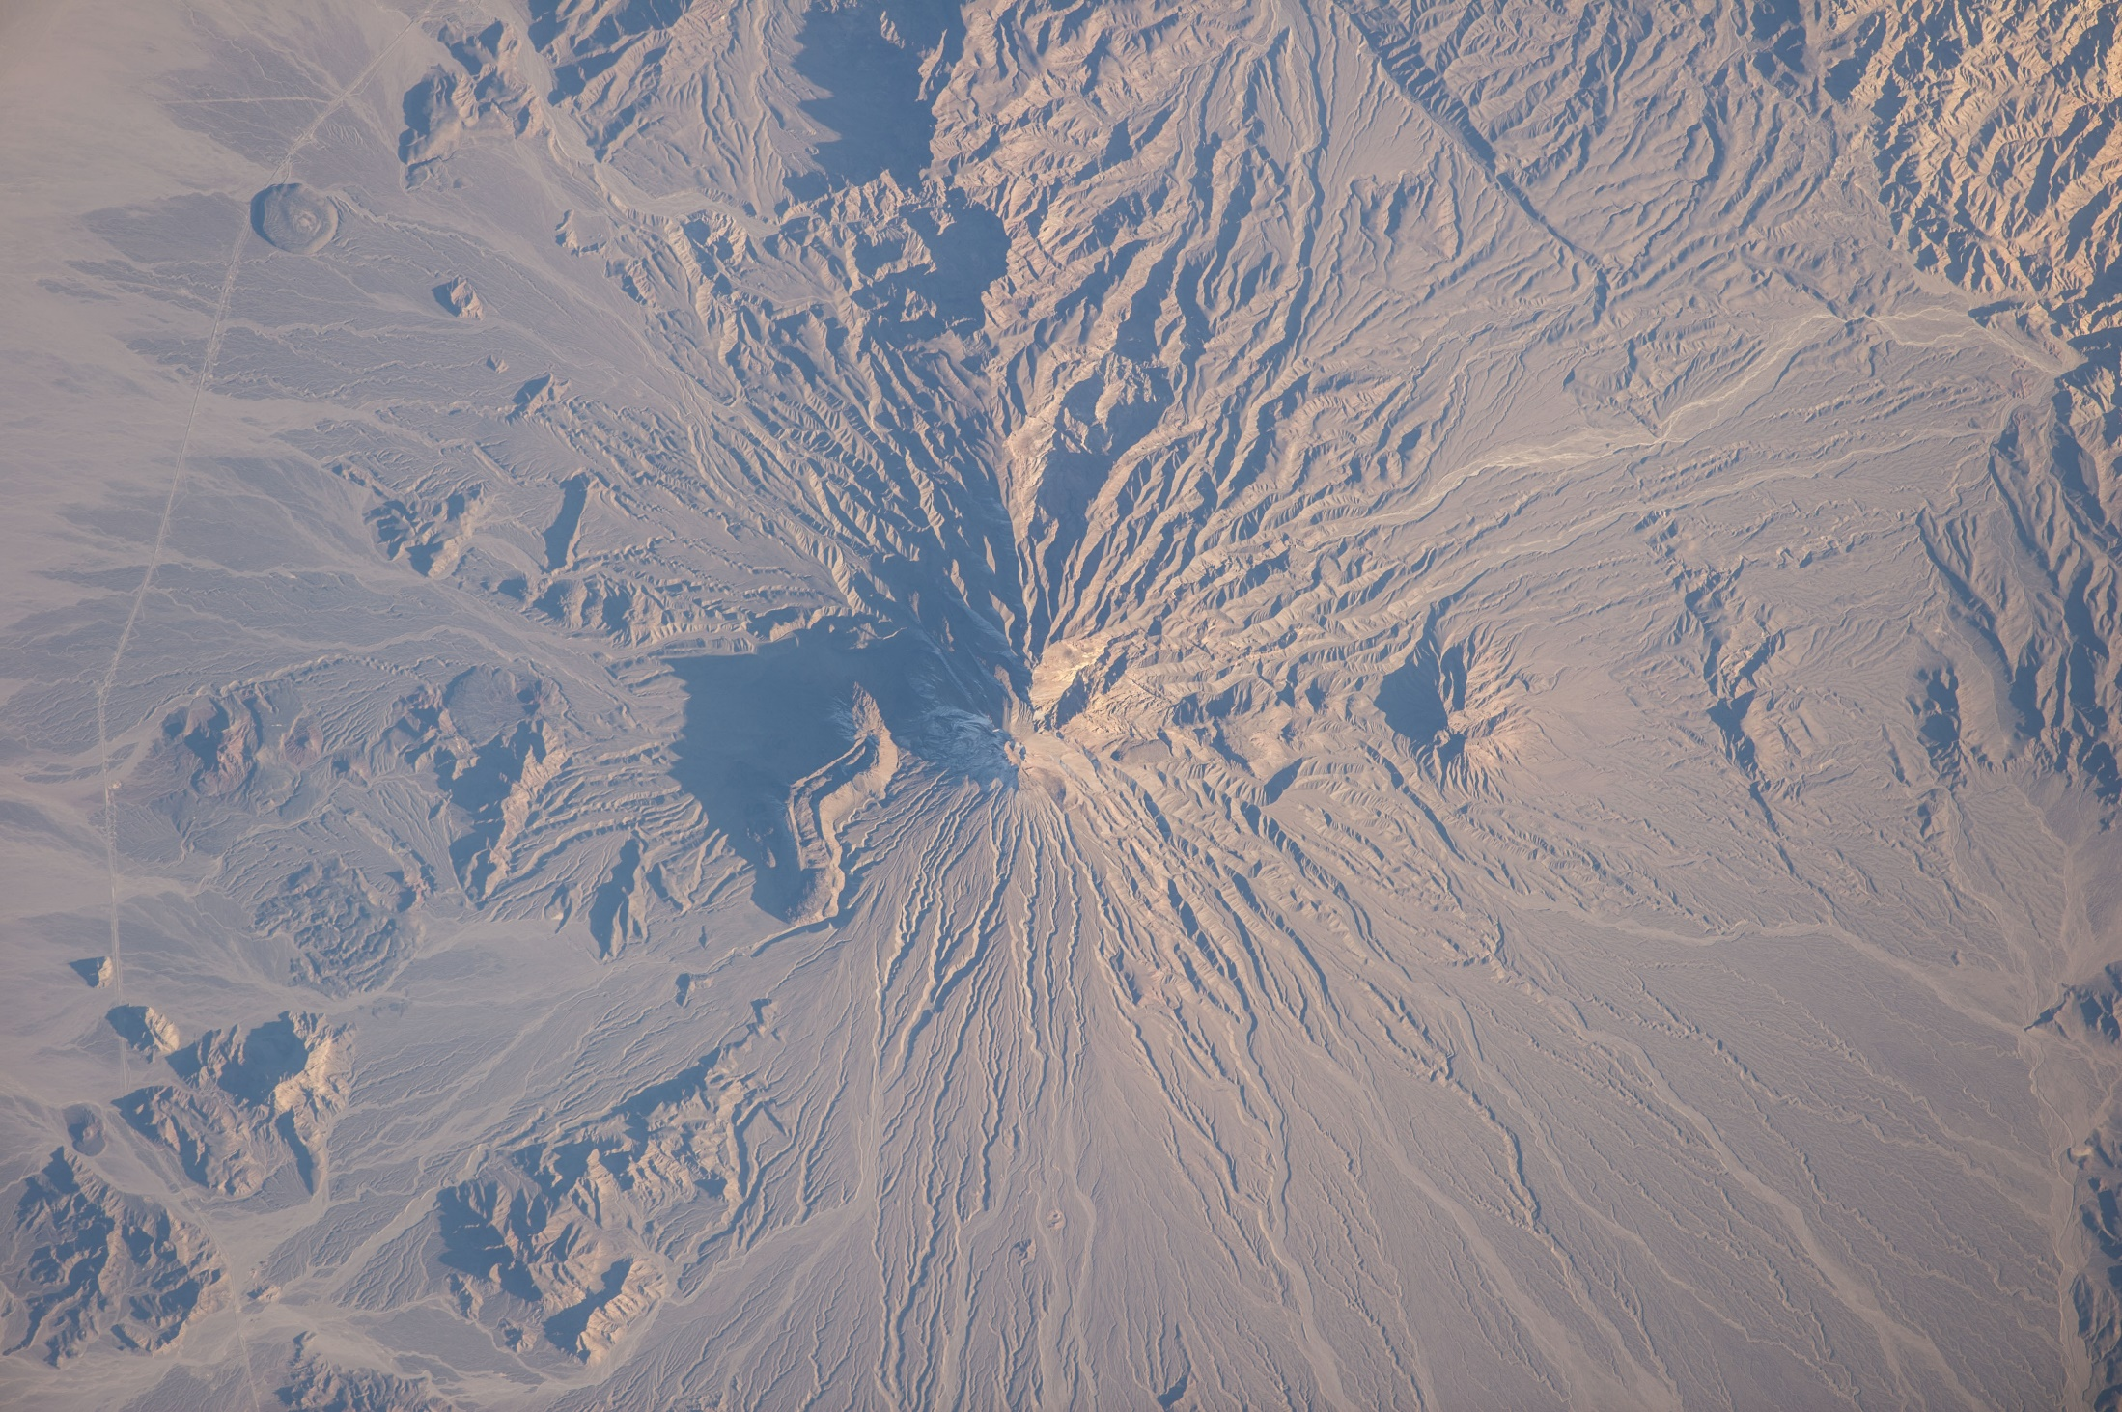
Notes:
Picture 6 – Earth. Bazman, a dormant volcano in Iran.
Image credit: NASA/JSC Earth Science and Remote Sensing Unit
https://www.nasa.gov/content/bazman-volcano-in-iran

Slide 12
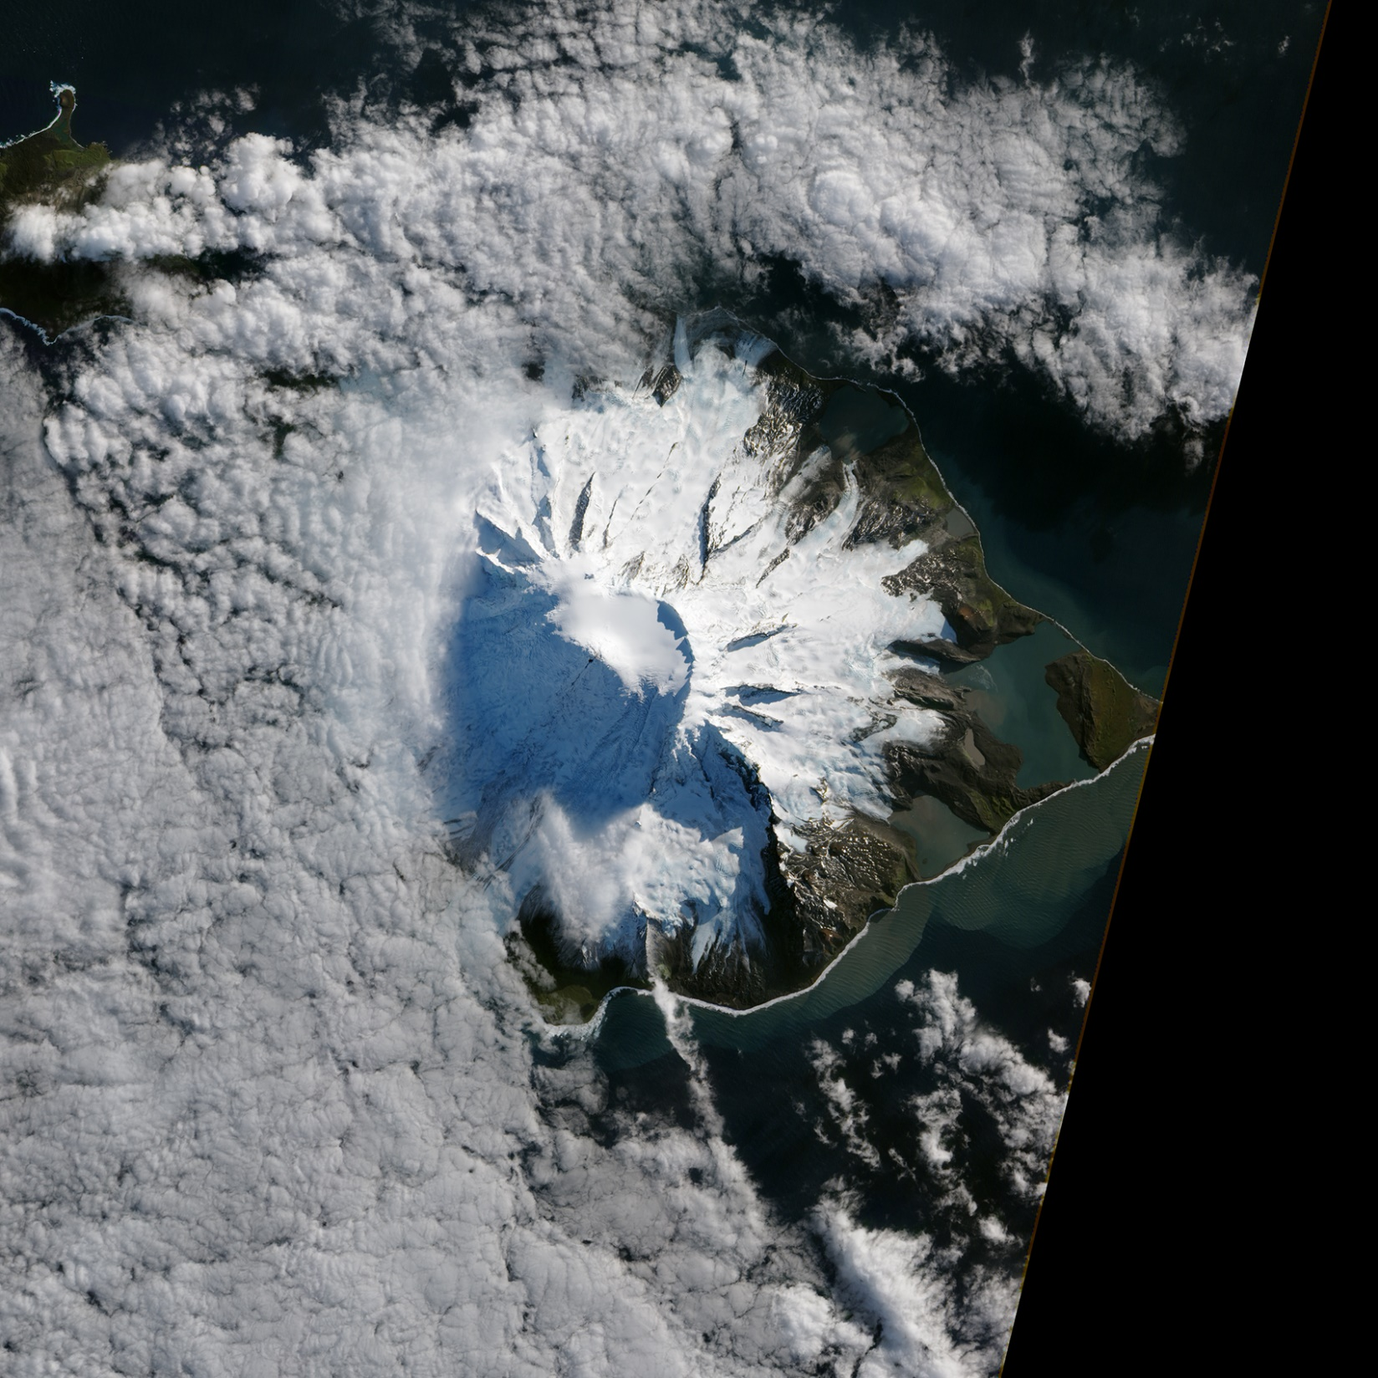
Notes:
Picture 7- Earth. Mawson Peak on the remote Heard Island (near Antarctica but considered Australian territory) is actually Australia’s most active volcano.
Image Credit: NASA Earth Observatory
https://www.nasa.gov/multimedia/imagegallery/image_feature_2500.html

Slide 13
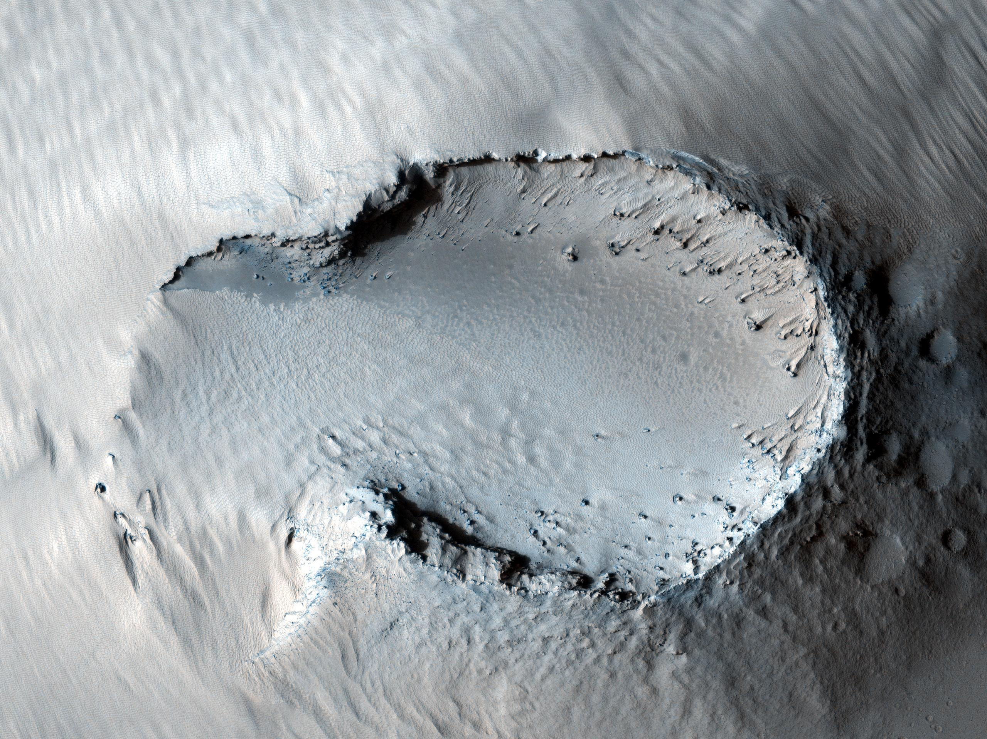
Notes:
Picture 8 – Mars. Small cone on one of Mars’ giant shield volcanoes.
Image Credit: NASA/ JPL-Caltech/ University of Arizona
https://www.nasa.gov/multimedia/imagegallery/image_feature_1802.html

Slide 14
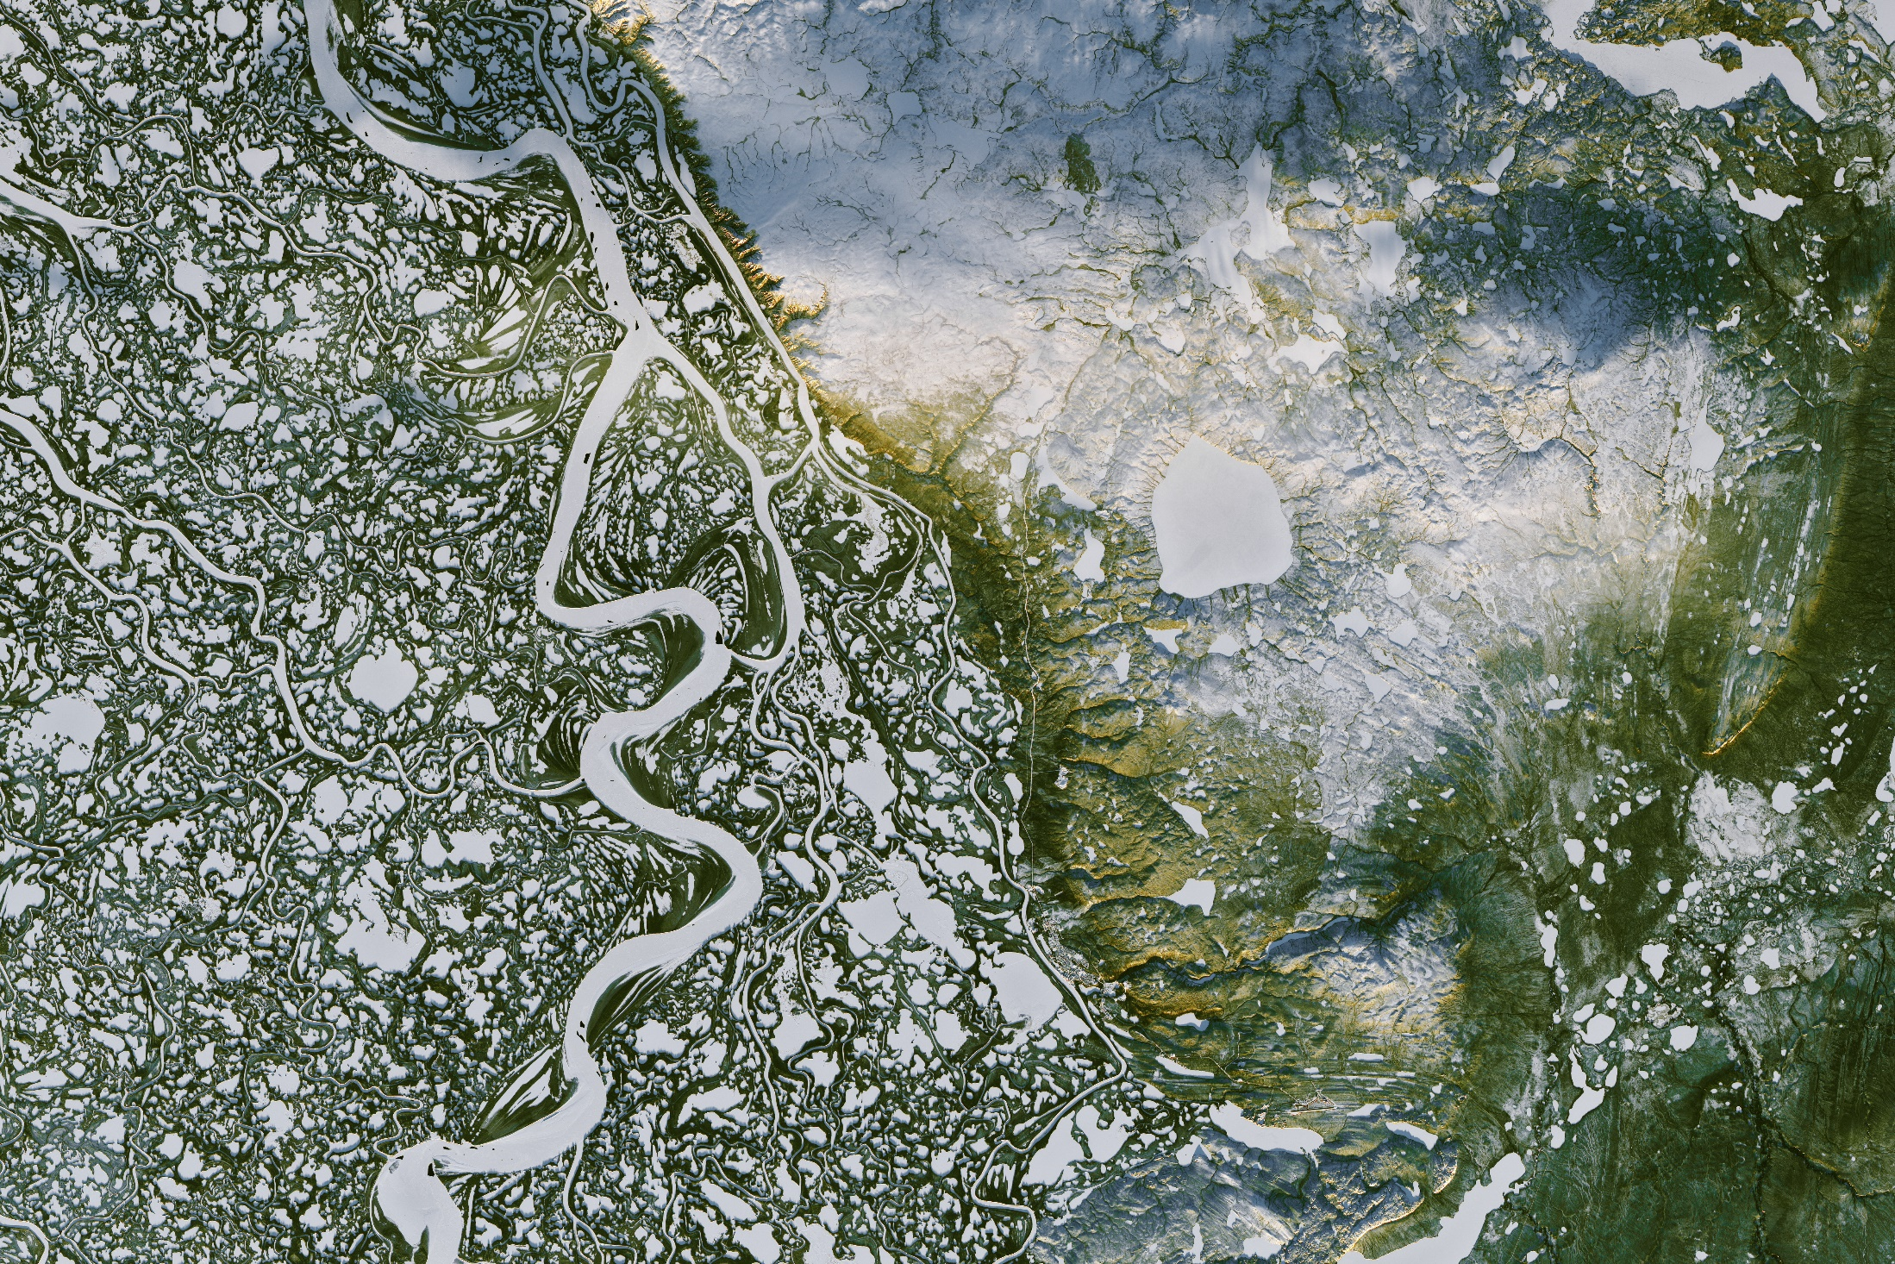
Notes:
Picture 9 - Earth. The frozen Mackenzie River Delta in Canada shows how water has carved the landscape.
Image credit: NASA Earth Observatory images by Joshua Stevens, using Landsat data from the U.S. Geological Survey
https://www.nasa.gov/image-feature/mackenzie-river-in-canadas-northwest-territories

Slide 15
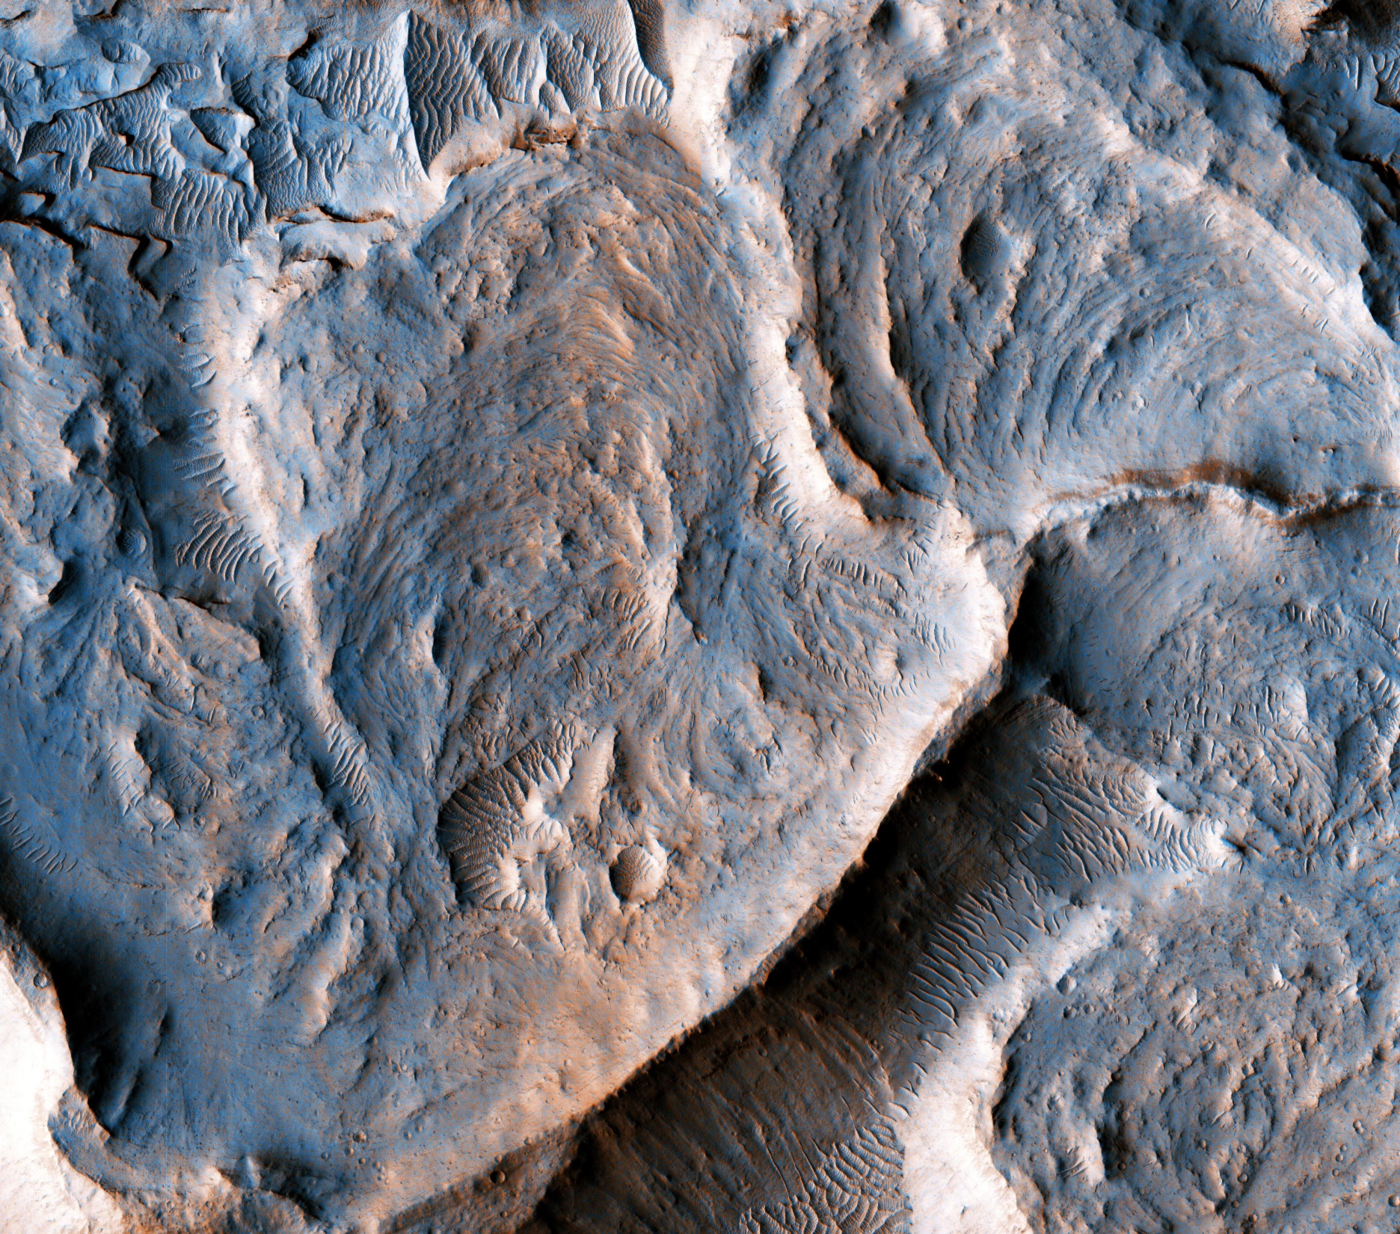
Notes:
Picture 10 – Mars. This photo shows an inverted fluvial channel near the equator of Mars. This is evidence of water possibly being present on Mars in the past.
Image credit: NASA/JPL-Caltech/Univ. of Arizona
https://www.nasa.gov/image-feature/jpl/pia21551/martian-meanders-and-scroll-bars

Slide 16
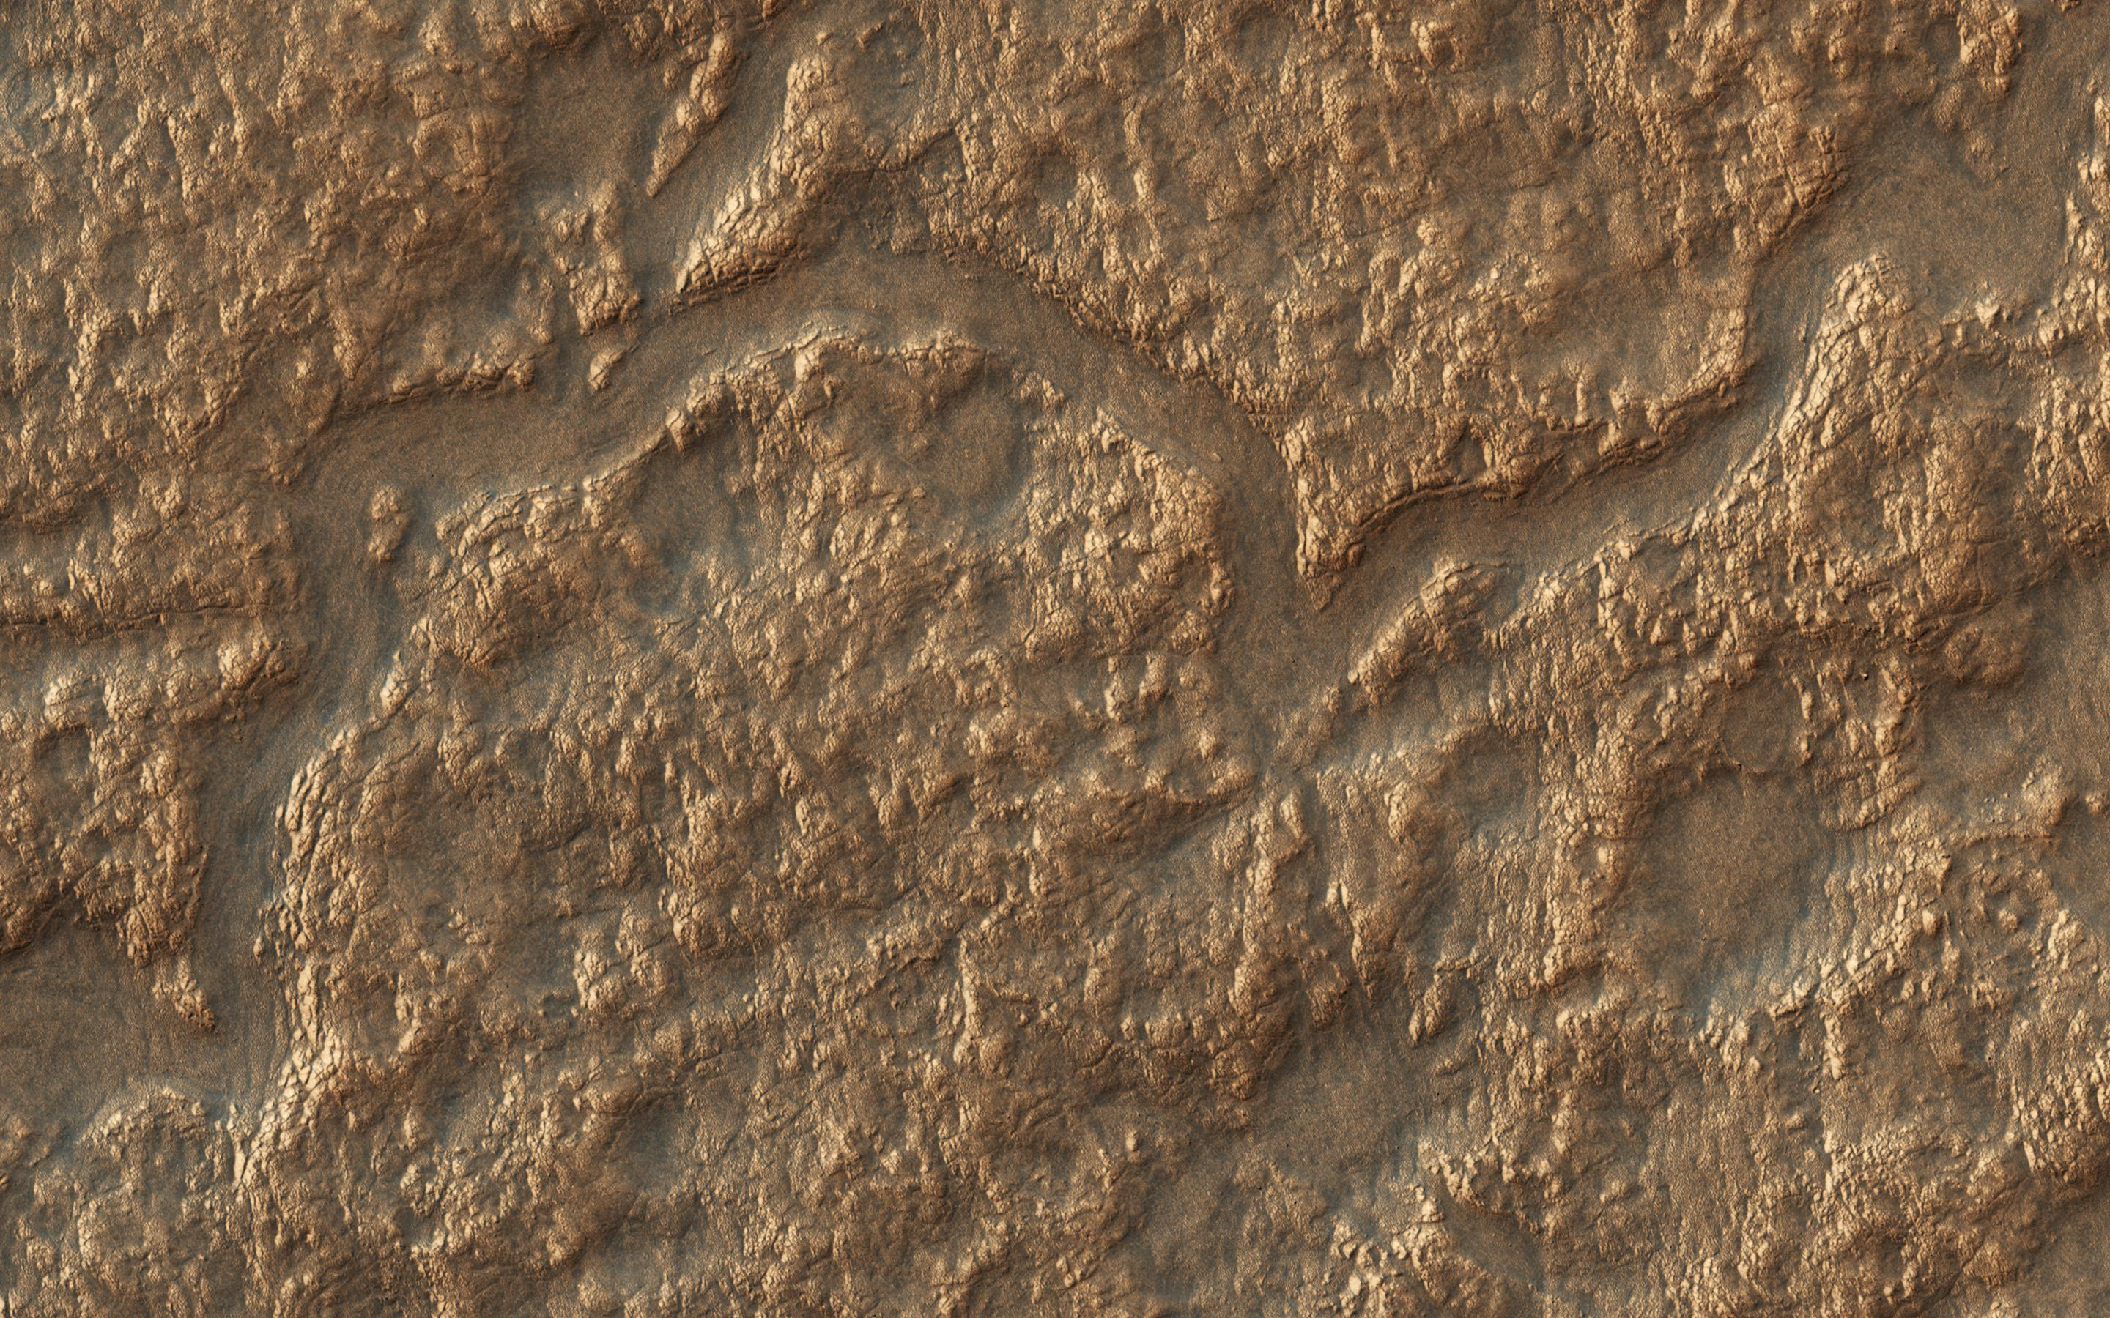
Notes:
Picture 11 – Mars. These channels on the floor of the Lyot crater on Mars resemble streams common in the Arctic region of Earth, suggesting there has possibly been water on Mars.
Image credit: NASA/JPL-Caltech/Univ. of Arizona
https://www.nasa.gov/image-feature/jpl/pia22186/depressions-and-channels-on-the-floor-of-lyot-crater

Slide 17
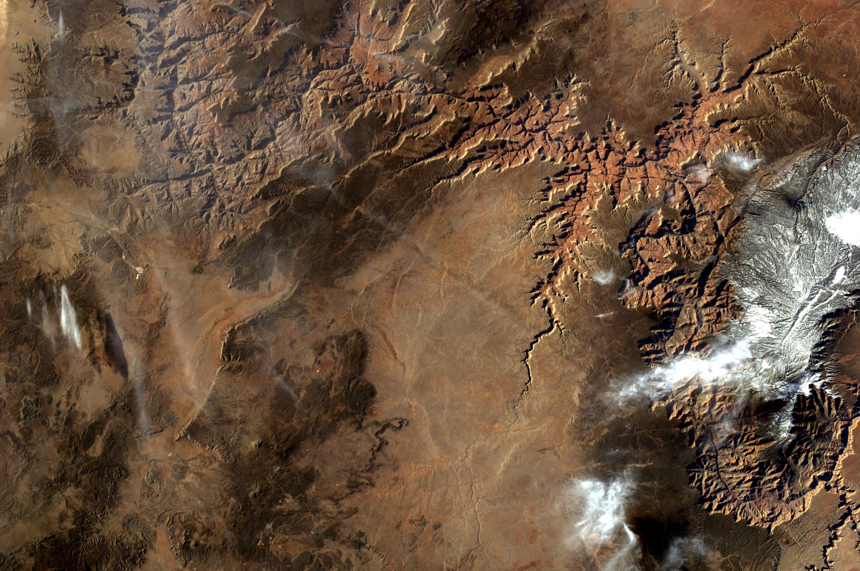
Notes:
Picture 12 – Earth. The iconic Grand Canyon has been carved out by the Colorado River.
Image credit: Sally Ride EarthKAM (photographed from the International Space Station using a camera controlled by school students on Earth!
https://www.nasa.gov/image-feature/space-stations-earthkam-sees-the-grand-canyon

Slide 18
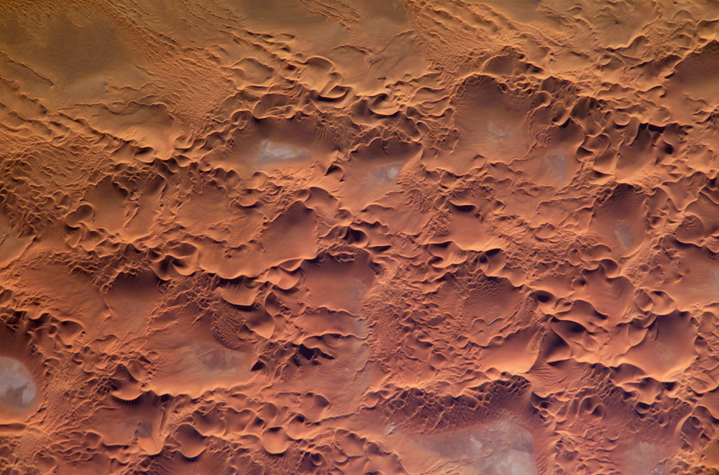
Notes:
Picture 13 – Earth. Sand dunes in Algeria.
Image credit: NASA/JSC Earth Science and Remote Sensing Unit
https://www.nasa.gov/multimedia/imagegallery/image_feature_275.html

Slide 19
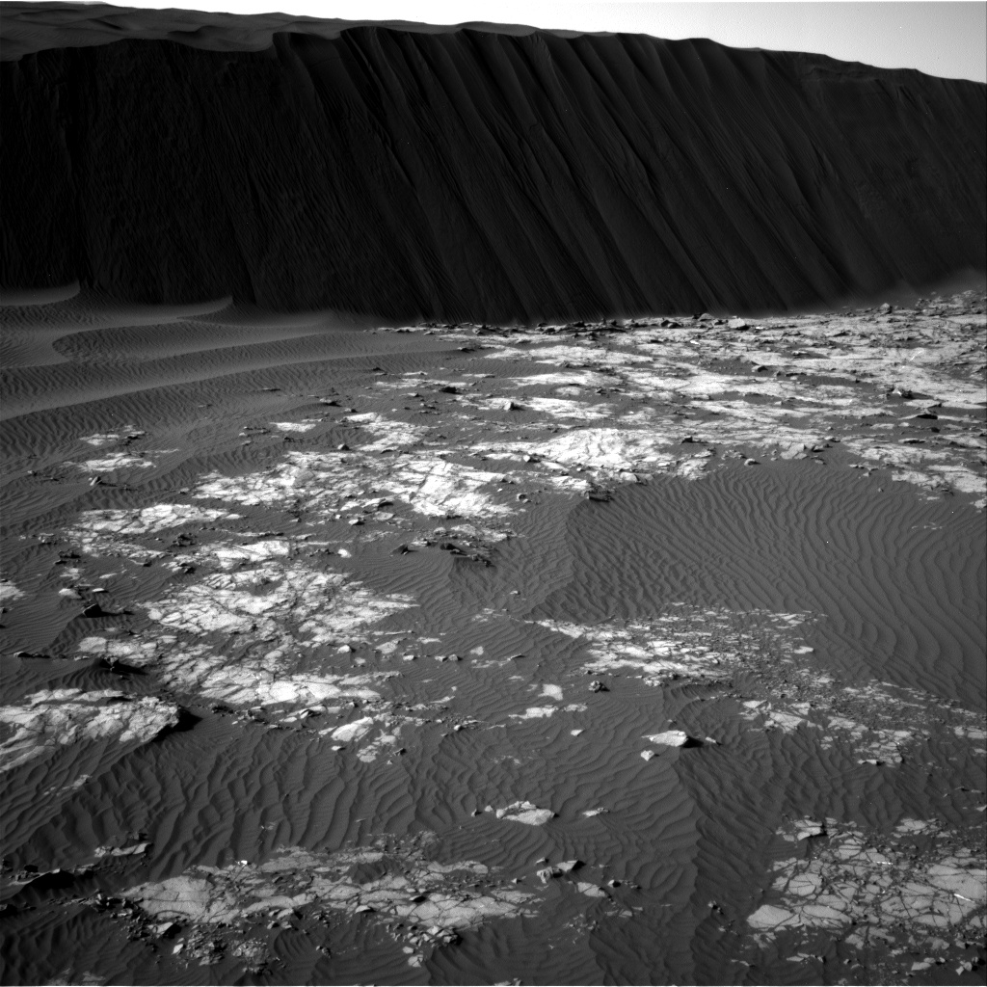
Notes:
Picture 14 – Mars. Ripples in sands on Mars.
Image Credit: NASA/JPL-Caltech. This image was taken by Navcam: Right B (NAV_RIGHT_B) onboard NASA's Mars rover Curiosity on Sol 1194 (2015-12-16 01:56:13 UTC).
http://mars.jpl.nasa.gov/msl-raw-images/proj/msl/redops/ods/surface/sol/01194/opgs/edr/ncam/NRB_503501845EDR_F0512704NCAM00271M_.JPG

Slide 20
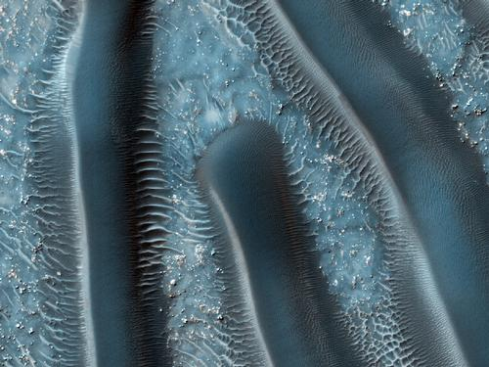
Notes:
Picture 15 – Mars. Sand dunes on Mars
Image credit: NASA/JPL – Caltech/University of Arizona
https://mars.nasa.gov/multimedia/marsasart/?ImageID=5304

Slide 21
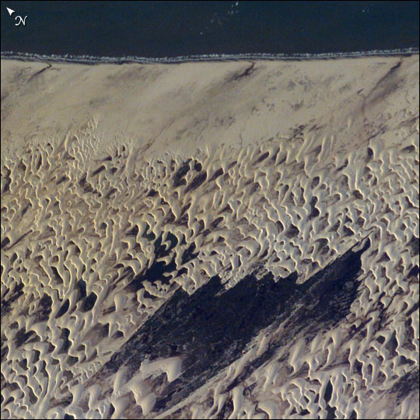
Notes:
Picture 16 – Earth. A dune field in the Lencois Maranhenses National Park on the north coast of Brazil.
Image credit: NASA/JSC Earth Science and Remote Sensing Unit
https://earthobservatory.nasa.gov/IOTD/view.php?id=3889

